Slide 1
The Battle of Neighbourhoods By G. PRADEEP
EXPLORING THE SAFEST BOROUGH IN LONDON BASED ON CRIME RATE

Slide 2
Introduction
Background
The average American moves about eleven times in their lifetime. This brings us to the question: Do people move until they find a place to settle down where they truly feel happy, or do our wants and needs change over time, prompting us to eventually leave a town we once called home for a new area that will bring us satisfaction? Or, do we too often move to a new area without knowing exactly what we’re getting into, forcing us to turn tail and run at the first sign of discomfort?
To minimize the chances of this happening, we should always do proper research when planning our next move in life. Consider the following factors when picking a new place to live so you don’t end up wasting your valuable time and money making a move you’ll end up regretting. Safety is a top concern when moving to a new area. If you don’t feel safe in your own home, you’re not going to be able to enjoy living there.

Slide 3
Problem
The crime statistics dataset of London found on Kaggle has crimes in each Boroughs of London from 2008 to 2016. The year 2016 being the latest we will be considering the data of that year which is actually old information as of now. The crime rates in each borough may have changed over time.
This project aims to select the safest borough in London based on the total crimes, explore the neighborhoods of that borough to find the 10 most common venues in each neighborhood and finally cluster the neighborhoods using k-mean clustering.
Interest
Expats who are considering to relocate to London will be interested to identify the safest borough in London and explore its neighborhoods and common venues around each neighborhood.

Slide 4
Data Acquisition and Cleaning
The data acquired for this project is a combination of data from three sources.
The first data source of the project uses a London crime data that shows the crime per borough in London.
The second source of data is scraped from a wikipedia page that contains the list of London boroughs.
The third data source is the list of Neighborhoods in the Royal Borough of Kingston upon Thames as found on a wikipedia page.

Slide 5
Data Cleaning
The data preparation for each of the three sources of data is done separately.
From the London crime data, the crimes during the most recent year (2016) are only selected. The major categories of crime are pivoted to get the total crimes per the boroughs for each major category
The second data is scraped from a wikipedia page using the Beautiful Soup library in python. Using this library we can extract the data in the tabular format as shown in the website.
The two datasets are merged on the Borough names to form a new dataset that combines the necessary information in one dataset . The purpose of this dataset is to visualize the crime rates in each borough and identify the borough with the least crimes recorded during the year 2016.

Slide 6
After visualizing the crime in each borough we can find the borough with the lowest crime rate. The third data set is created, with the names of the neighbourhoods and the name of the borough with the latitude and longitude obtained using Google Maps API geocoding
The new dataset is used to generate the 10 most common venues for each neighborhood using the Foursquare API, finally using k means clustering algorithm to cluster similar neighborhoods together.

Slide 7
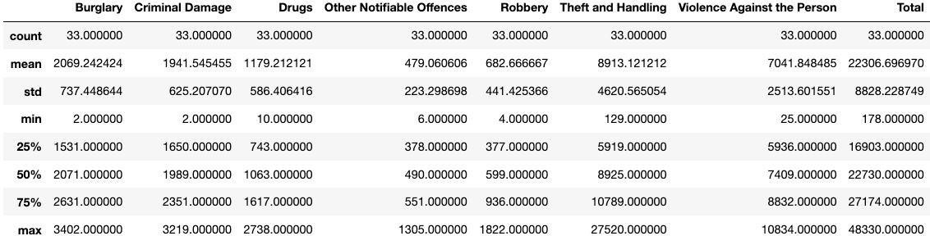
Methodology
Exploratory Data Analysis
Statistical summary of crimes
The count for each of the major categories of crime returns the value 33 which is the number of London boroughs. ‘Theft and Handling’ is the highest reported crime during the year 2016 followed by ‘Violence against the person’, ‘Criminal damage’. The lowest recorded crimes are ’Drugs’, ‘Robbery’ and ‘Other Notifiable offenses’.

Slide 8
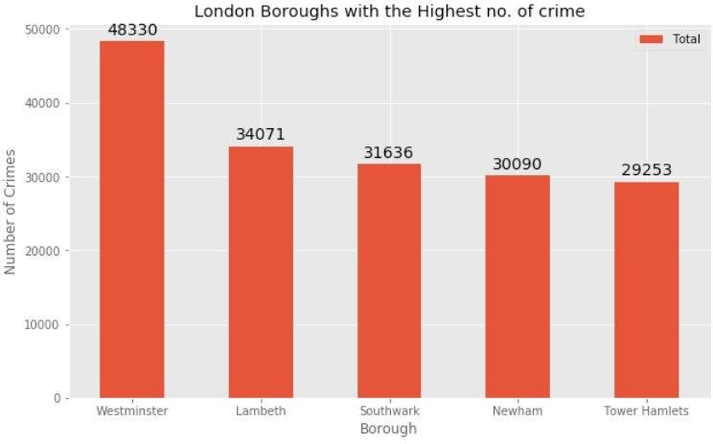
Comparing five boroughs with the highest crime rate during the year 2016 it is evident that Westminster has the highest crimes recorded followed by Lambeth, Southwark, Newham and Tower Hamlets. Westminster has a significantly higher crime rate than the other 4 boroughs
Boroughs with the highest crime rates

Slide 9
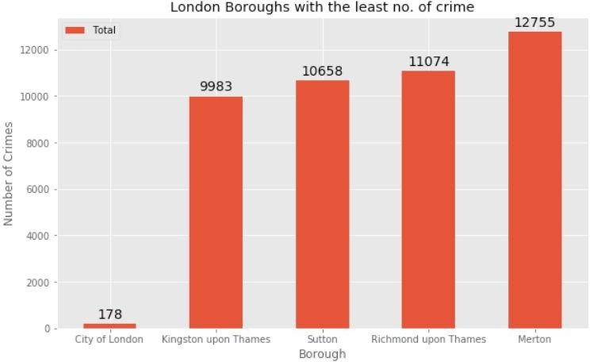
Boroughs with the lowest crime rates
Comparing five boroughs with the lowest crime rate during the year 2016, City of London has the lowest recorded crimes followed by Kingston upon Thames, Sutton, Richmond upon Thames and Merton
City of London has a significantly lower crime rate because it i is the 33rd principal division of Greater London but it is not a London borough. It has an area of 1.12 square miles and a population of 7000 as of 2013 which suggests that it is a small area
We will consider the next borough with the lowest crime rate as the safest borough in London which is Kingston upon Thames.

Slide 10
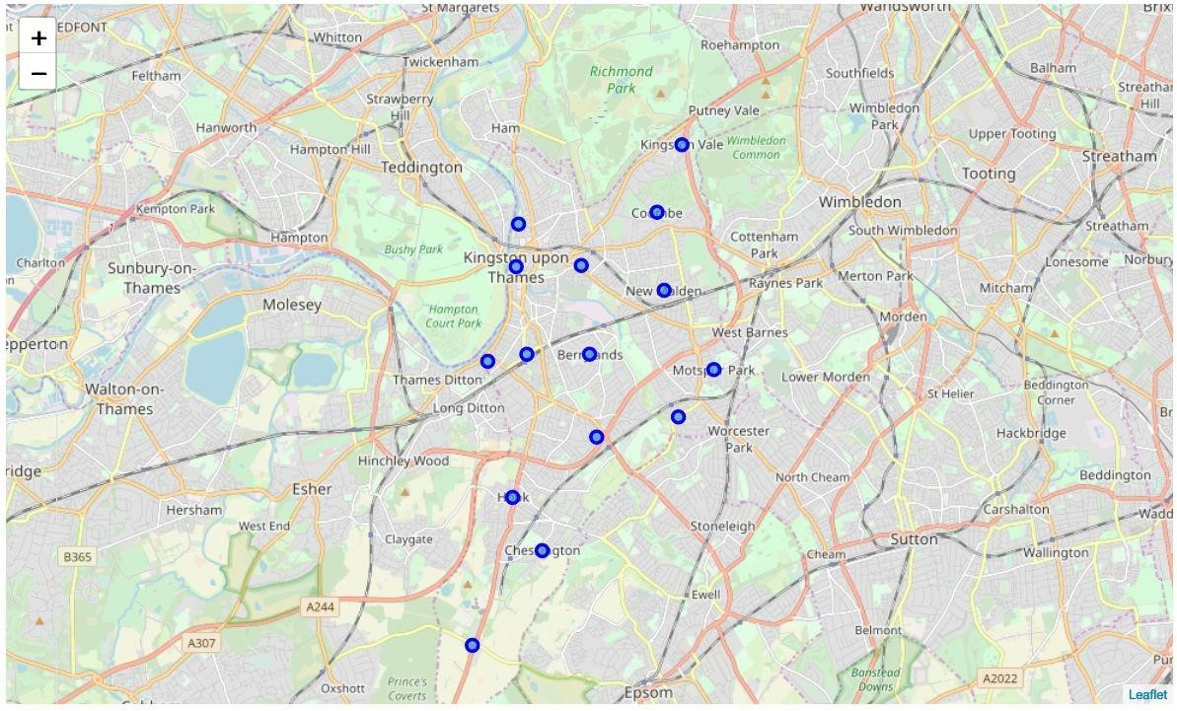
Neighborhoods in Kingston upon Thames
There are 15 neighborhoods in the royal borough of Kingston upon Thames, they are visualised on a map using folium on python

Slide 11
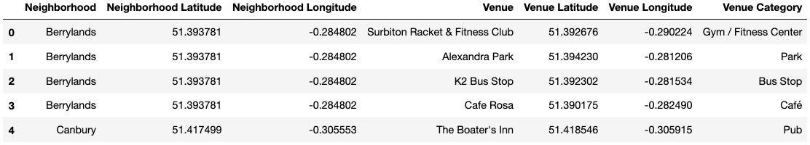
Modelling
Using the final dataset containing the neighborhoods in Kingston upon Thames along with the latitude and longitude, we can find all the venues within a 500 meter radius of each neighborhood by connecting to the Foursquare API.
One hot encoding is done on the venues data. The Venues data is then grouped by the Neighborhood and the mean of the venues are calculated, finally the 10 common venues are calculated for each of the neighborhoods.
We will use a cluster size of 5 for this project that will cluster the 15 neighborhoods into 5 clusters. The reason to conduct a K- means clustering is to cluster neighborhoods with similar venues together so that people can shortlist the area of their interests based on the venues/amenities around each neighborhood.

Slide 12
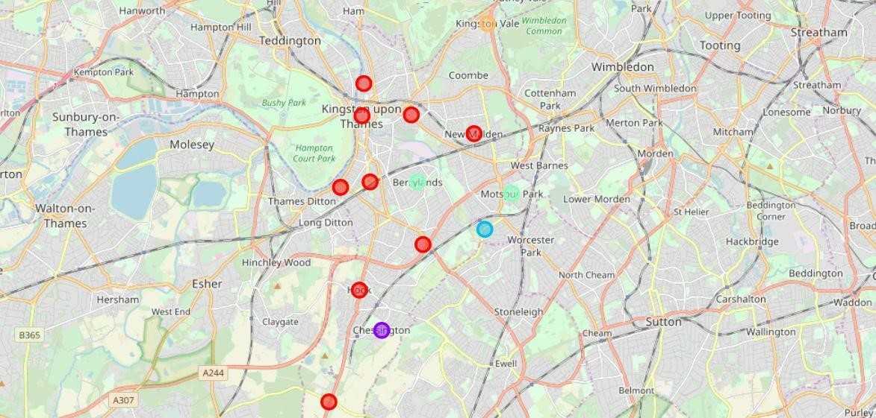
Results
After running the K-means clustering we can access each cluster created to see which neighborhoods were assigned to each of the five clusters. Visualizing the clustered neighbourhoods on a map using the folium library
Each cluster is color coded for the ease of presentation, we can see that majority of the neighborhood falls in the red cluster which is the first cluster. Three neighborhoods have their own cluster (Blue, Purple and Yellow), these are clusters two three and five. The green cluster consists of two neighborhoods which is the 4th cluster.

Slide 13
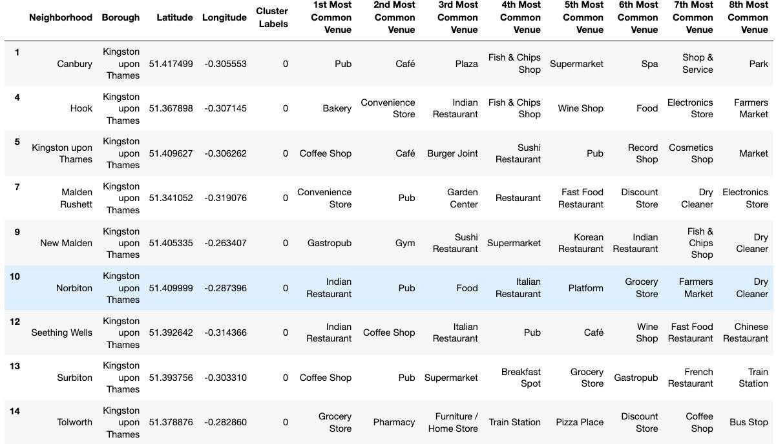
Cluster 1: Looking into the neighbourhoods in the first cluster
The cluster one is the biggest cluster with 9 of the 15 neighborhoods in the borough Kingston upon Thames. Upon closely examining these neighborhoods we can see that the most common venues in these neighborhoods are Restaurants, Pubs, Cafe, Supermarkets, and stores.

Slide 14
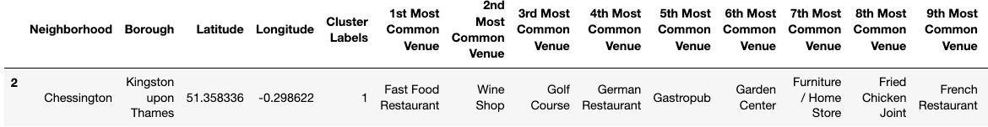
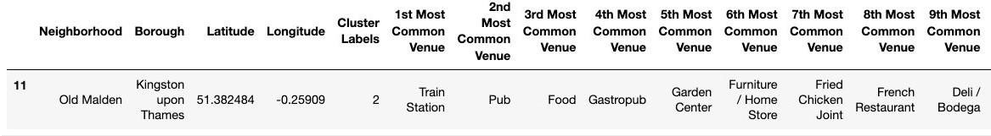
Cluster 2: Looking into the neighborhoods in the second Cluster
The second cluster has one neighborhood which consists of Venues such as Restaurants, Golf courses, and wine shops.
Cluster 3: Looking into the neighborhoods in the third Cluster
The third cluster has one neighborhood which consists of Venues such as Train stations, Restaurants, and Furniture shops.

Slide 15
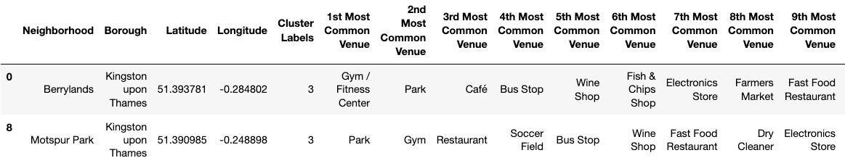
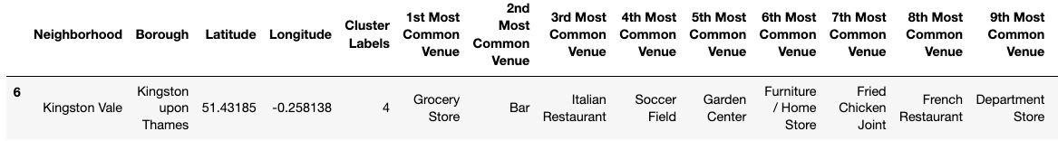
Cluster 4: Looking into the neighborhoods in the Fourth Cluster
The fourth cluster has two neighborhoods in it, these neighborhoods have common venues such as Parks, Gym/Fitness centers, Bus Stops, Restaurants, Electronics Stores and Soccer fields etc.
Cluster 5: Looking into the neighborhoods in the Fifth Cluster
The fifth cluster has one neighborhood which consists of Venues such as Grocery shops, Bars, Restaurants, Furniture shops, and Department stores.

Slide 16
Discussion
The aim of this project is to help people who want to relocate to the safest borough in London, expats can chose the neighborhoods to which they want to relocate based on the most common venues in it.
For example if a person is looking for a neighborhood with good connectivity and public transportation we can see that Clusters 3 and 4 have Train stations and Bus stops as the most common venues.
If a person is looking for a neighborhood with stores and restaurants in a close proximity then the neighborhoods in the first cluster is suitable.
For a family I feel that the neighborhoods in Cluster 4 are more suitable dues to the common venues in that cluster, these neighborhoods have common venues such as Parks, Gym/Fitness centers, Bus Stops, Restaurants, Electronics Stores and Soccer fields which is ideal for a family.
The choices of neighborhoods may vary from person to person.

Slide 17
Conclusion
This project helps a person get a better understanding of the neighborhoods with respect to the most common venues in that neighborhood. It is always helpful to make use of technology to stay one step ahead i.e. finding out more about places before moving into a neighborhood.
We have just taken safety as a primary concern to shortlist the safest borough of London. The future of this project includes taking other factors such as cost of living in the areas into consideration to shortlist the borough, such as filtering areas based on a predefined budget.

